Slide 1
Mobile Price Prediction using Machine Learning Algorithms
Project 4
Submitted by –Ajit Kumar

Slide 2
Project Overview
The objective of this project is to develop a predictive model that accurately estimates the prices of mobile phones based on key features. By conducting a comprehensive feature extraction analysis, we aim to identify and prioritize the most influential factors affecting mobile phone pricing in the current competitive market. This insight will enable our organization to enhance its pricing strategy, optimize product offerings, and improve overall market competitiveness.
Key Objectives:
Identify Key Influencers: Determine the primary variables driving mobile prices.
Advanced Analytics: Utilize Machine Learning algorithms, KPI metrics , Cross validation methods to predict the mobile prices.
Data-Driven Insights: Create visualizations to represent relationships and trends within the data

Slide 3
Tools and Frameworks used
Tool used- Python
Frameworks used- Pandas , Numpy , Matplotlib , Seaborn ,SKLearn
ML Models used- Linear Regression , Logistic Regression , Random Forest , Decision Tree , Support Vector , Adaboost Regressor , XGBoost Regressor.
KPI Metrics for ML evaluation – R2 squared , Mean absolute error , Mean squared error
Methodology:
Data Exploration: Analyze the dataset to understand correlations and relationships.
Visualization: Develop charts and graphs to illustrate key findings and support strategic decisions.
Feature Extraction- to identify the most relevant features that strongly affect the price of mobile phones.
Model Building - Split the dataset into training and testing sets. Develop a machine learning model for price prediction..
Model Evaluation - Evaluate the model's performance using appropriate metrics (e.g., mean absolute error, root mean squared error) and cross validation method to assess how accurately it predicts mobile phone prices.

Slide 4
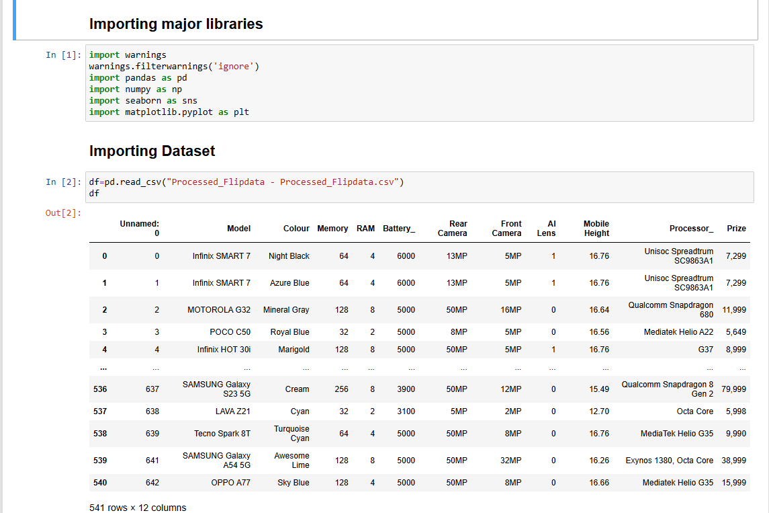
Importing data and major libraries

Slide 5
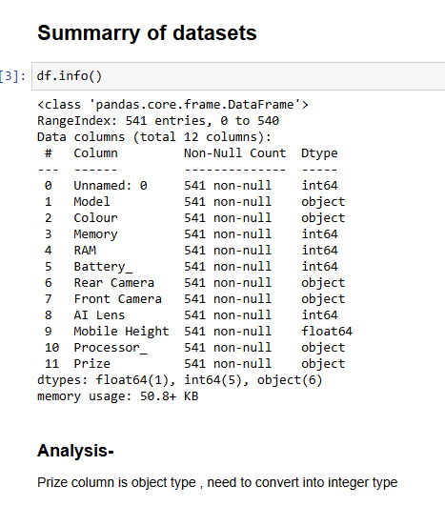
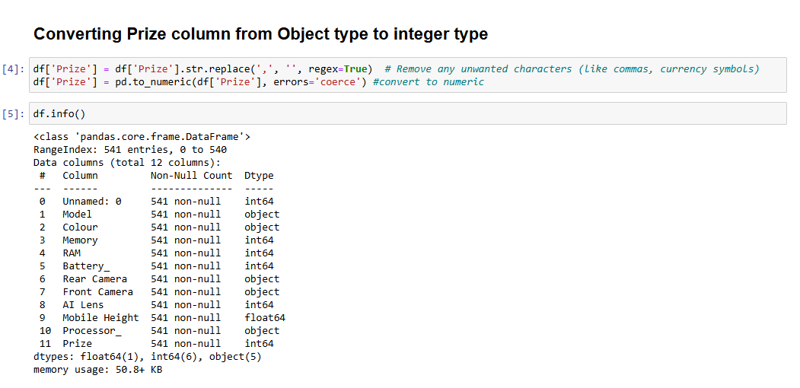
Checking data attributes
Checking data summary
Converting Prize column from Object type to Integer type

Slide 6
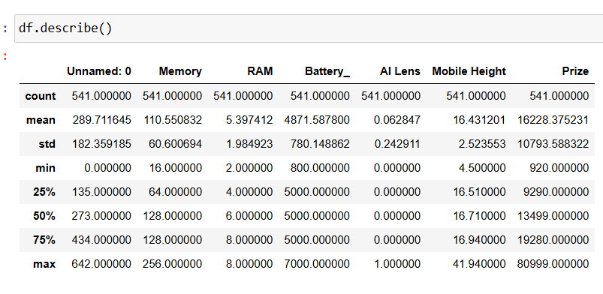
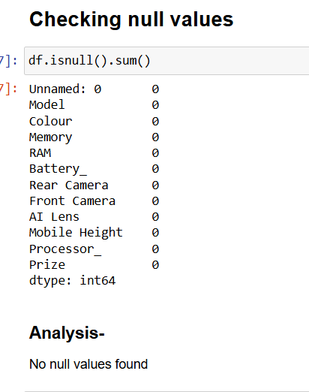
Checking data attributes
Checking data statistical info
Checking null values

Slide 7
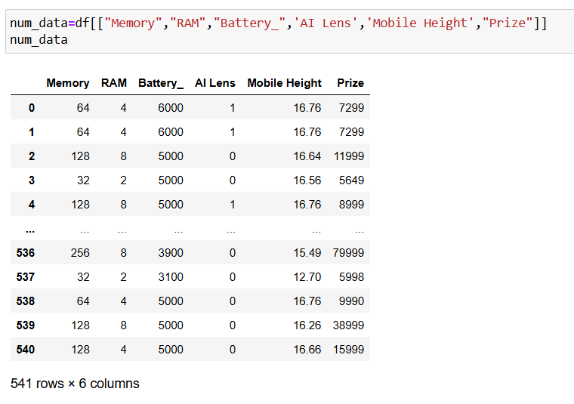
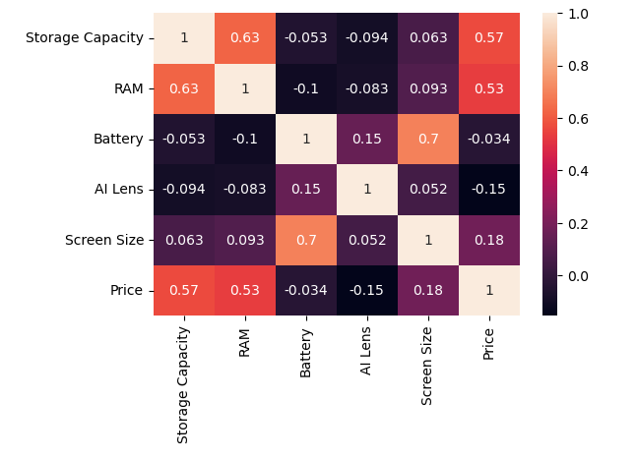
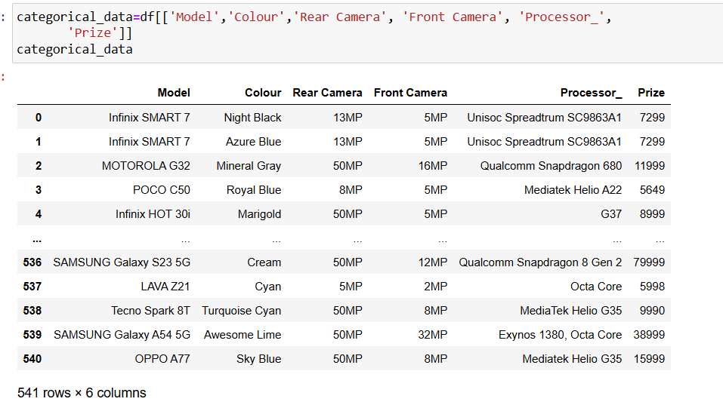
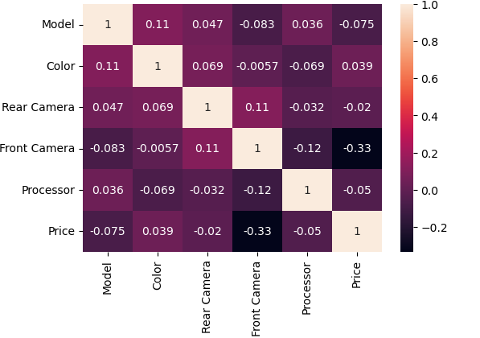
Splitting the dataset into Numerical and Categorical datasets to check correlation
Analysis-
Numerical variables having correlation with Prize with their score-
1.Memory
2. RAM
Analysis-
No Categorical variables having mid-level or high-level correlation with Prize column with their score-
Note:-
1.Score with >0.75 is considered as highly correlated
2. Score 0.5 to 0.75 are moderately correlated
3.Score <0.25 are less correlated

Slide 8
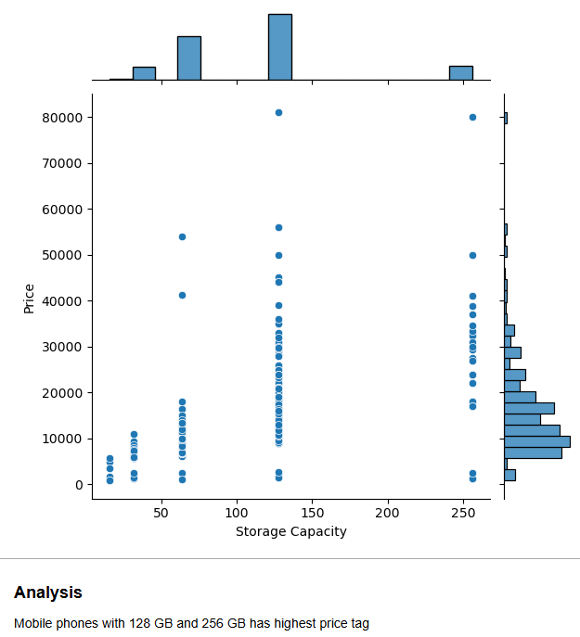
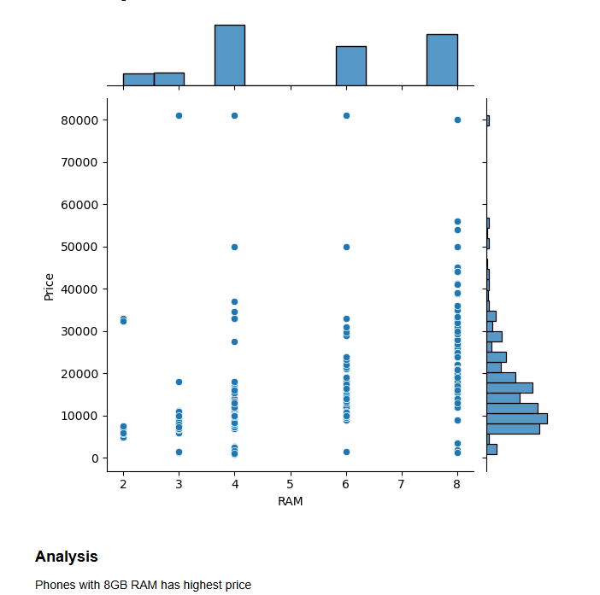
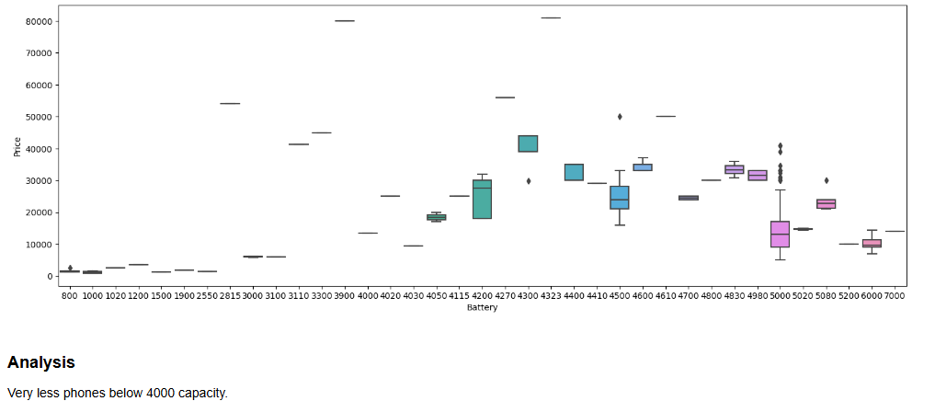
Multivariance analysis of Numerical and Categorical data

Slide 9
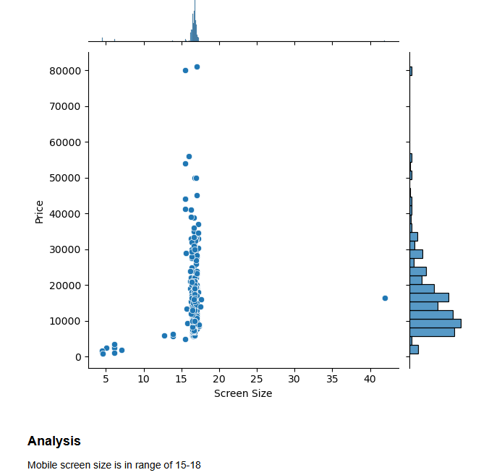
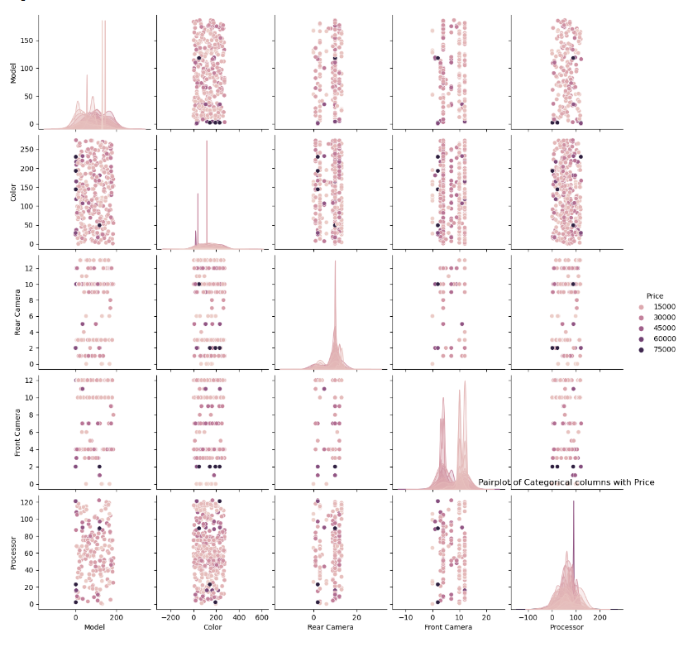
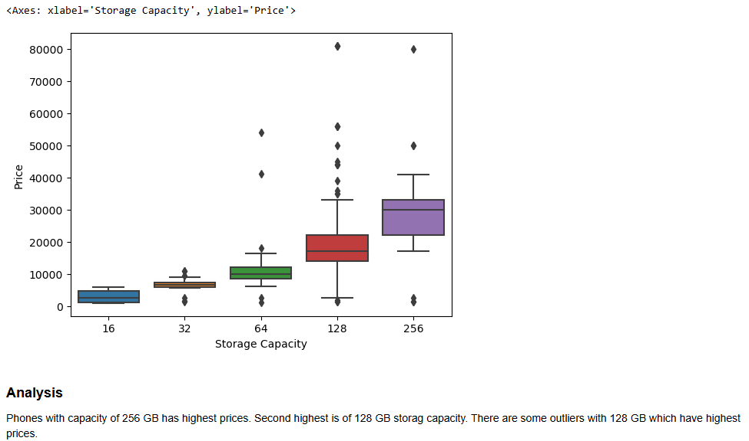
Multivariance analysis of Numerical and Categorical data

Slide 10
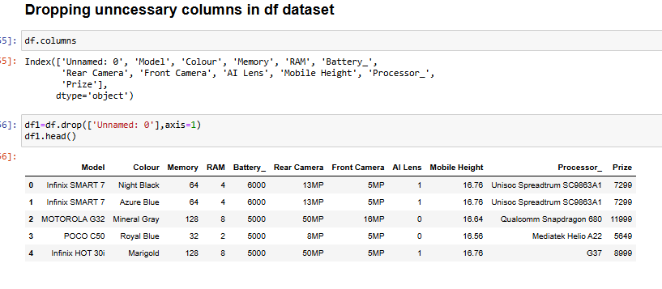
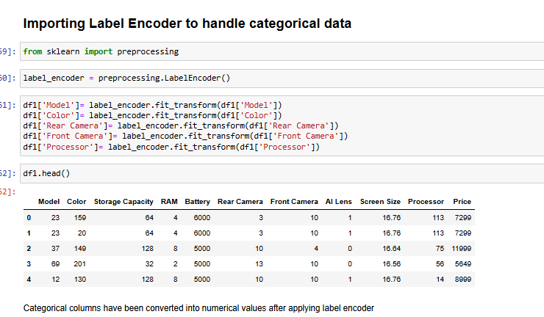
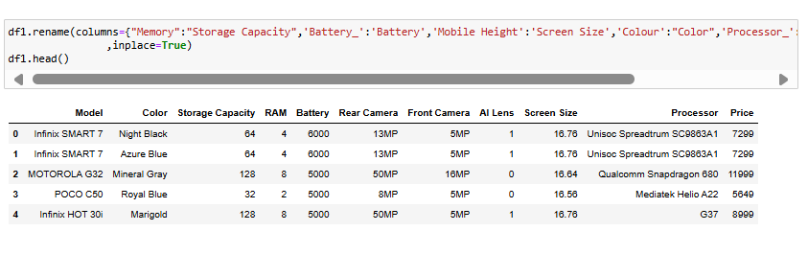
Handling categorical data
Dropping unnecessary columns
Importing label encoders for categorical data handling
Renaming columns name

Slide 11
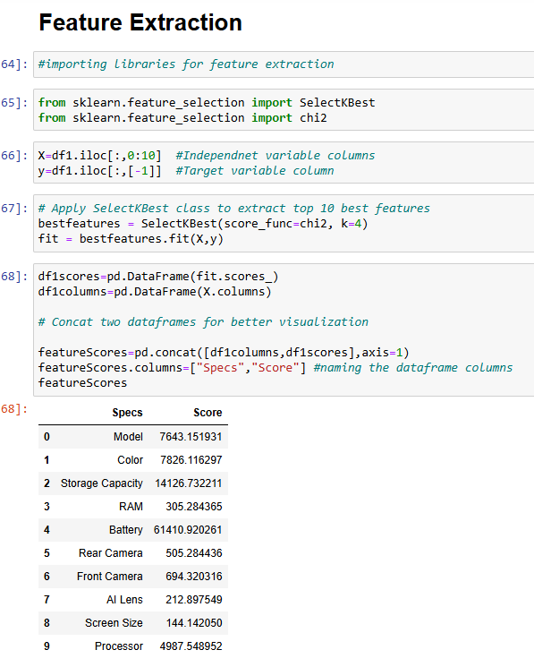
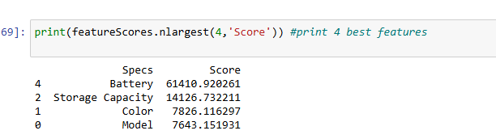
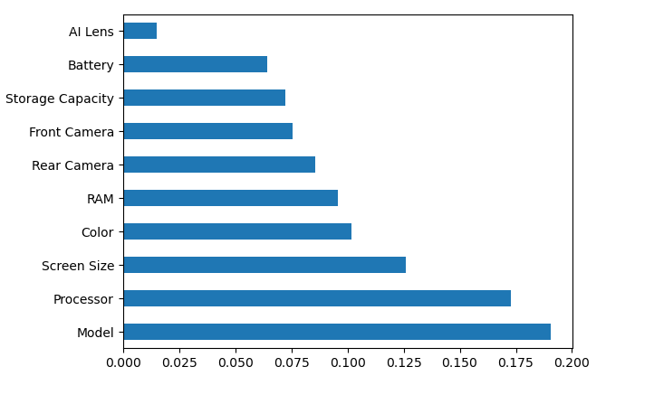
Feature Extraction
Best 4 features according to the score
Graph of feature importance's

Slide 12
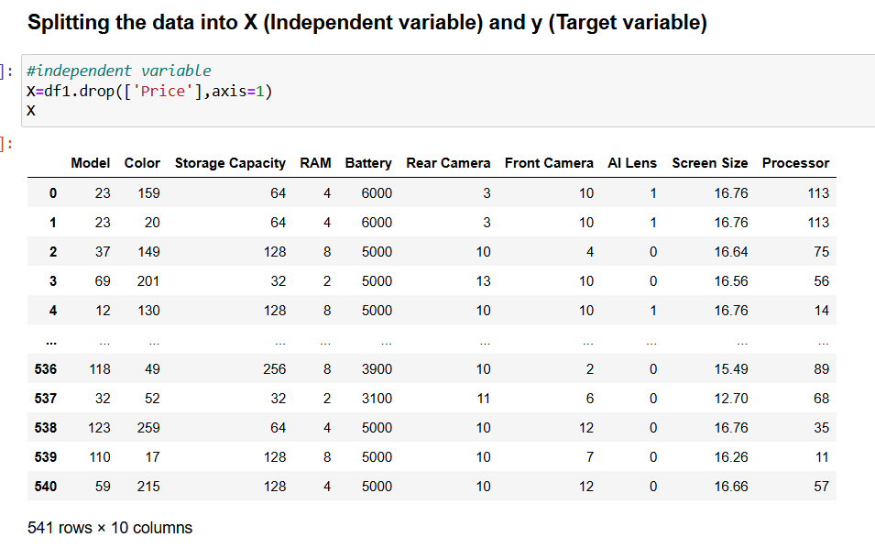
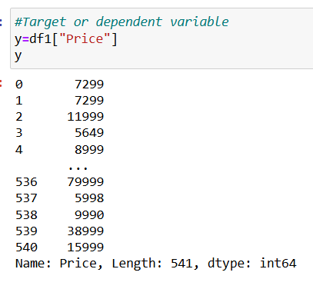
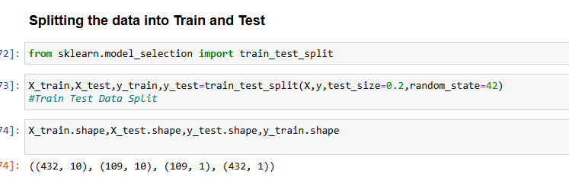
Model Building
1. Splitting the data
into Training and Testing data.
2. X being independent variable and y as target variable
3. Test size will be of 20% of data

Slide 13
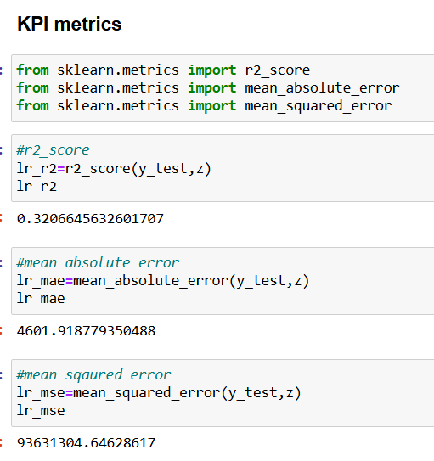
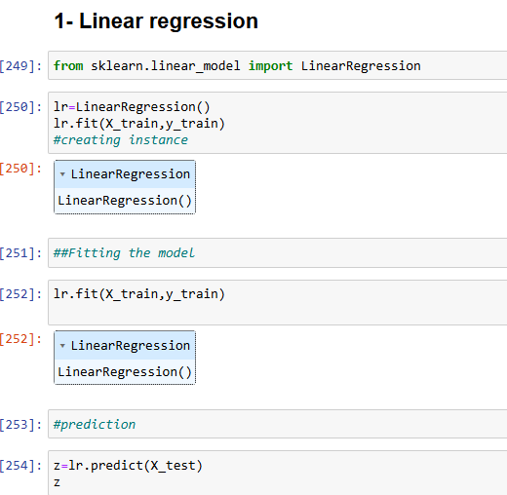
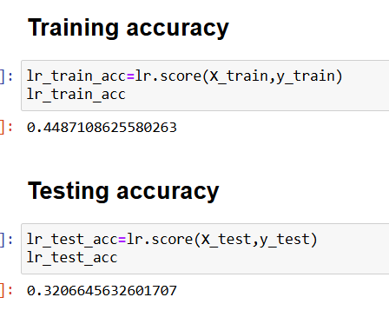
Linear Regression
Steps for model building-
Importing Linear regression
Fitting the linear regression on training data
Predicting the test data
Checking Accuracy
Model Evaluation using KPI metrics
Importing KPI metrics for Model evaluation-
R2 square
Mean absolute error
Mean squared error
Models shows good fit as there is less difference between Training and testing data accuracy.
However accuracy is very low

Slide 14
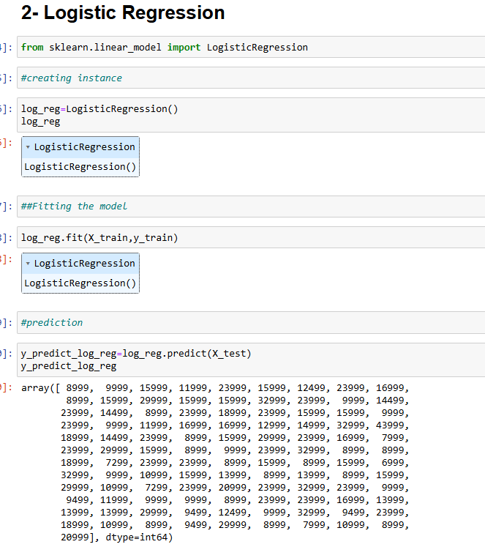
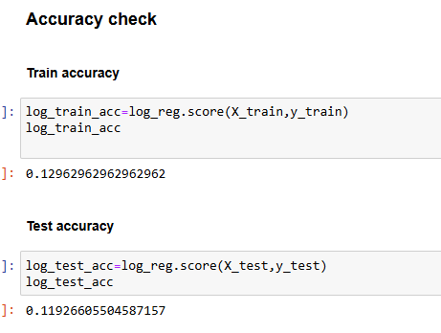
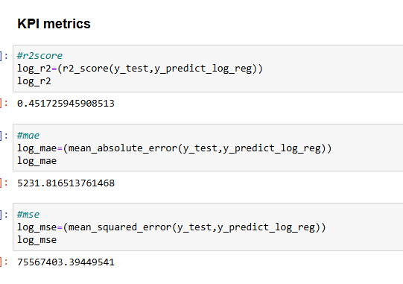
Logistic Regression
Model showing very low accuracy for this algorithm

Slide 15
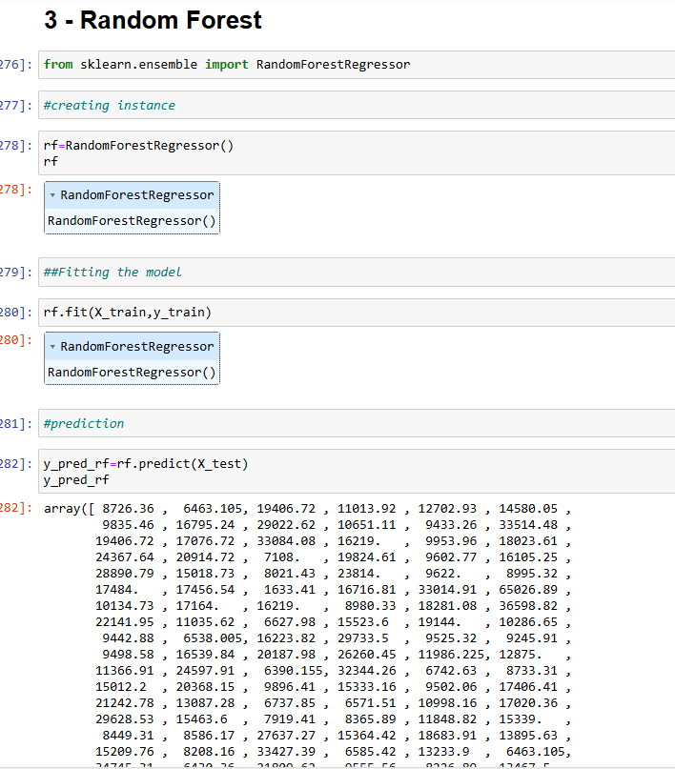
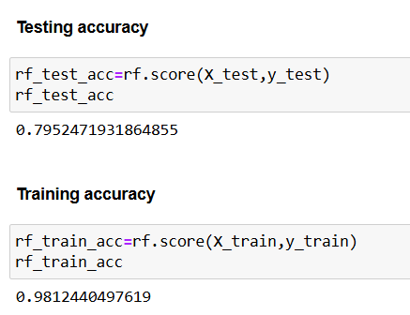
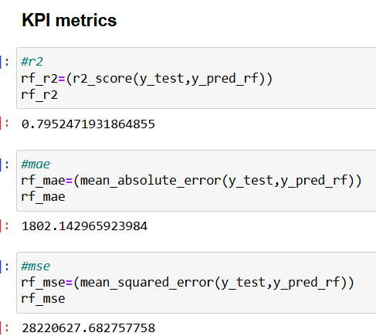
Random Forest
Model showing good accuracy.
However there is 20% gap between testing accuracy and training accuracy.

Slide 16
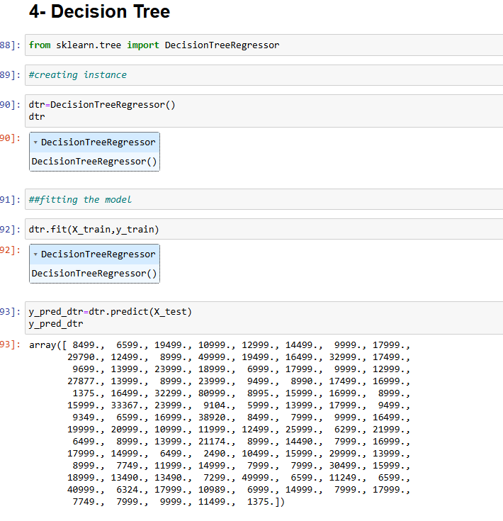
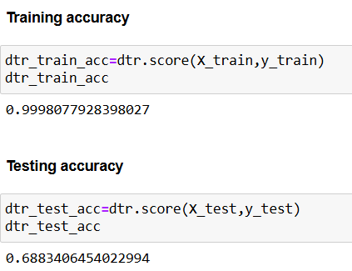
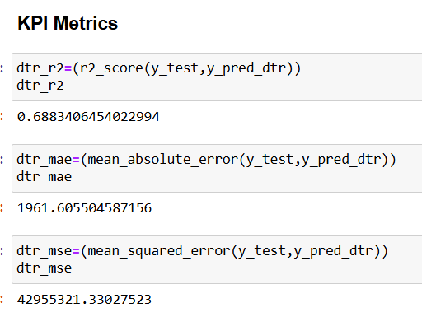
Decision Tree
Model showing good accuracy.
However there is more than 30% gap between testing accuracy and training accuracy.

Slide 17
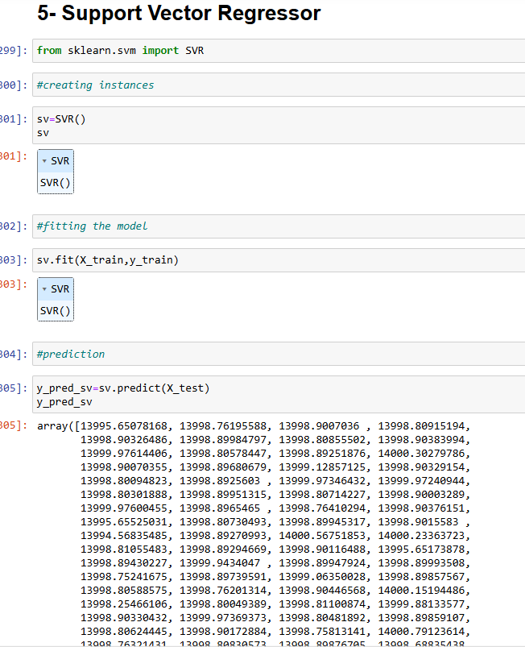
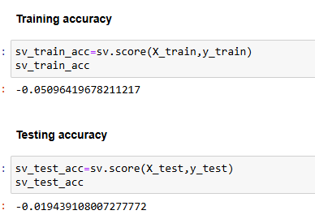
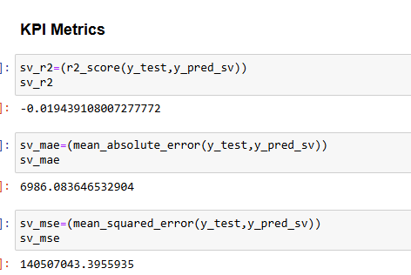
Support Vector Regressor
Model showing negative accuracy.

Slide 18
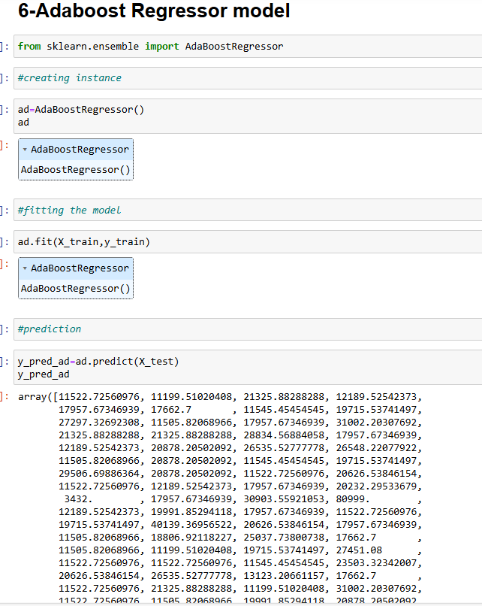
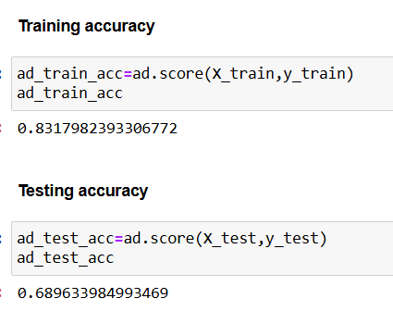
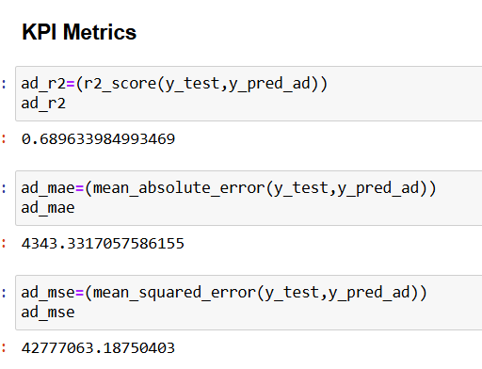
Adaboost regressor
Model showing good accuracy.
This model seems to best fit as there is less gap between testing and training accuracy.

Slide 19
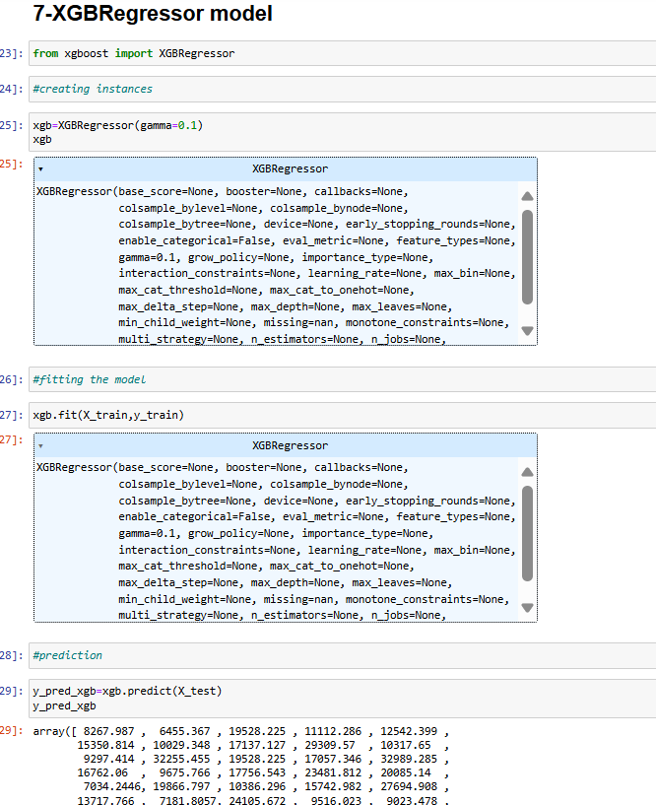
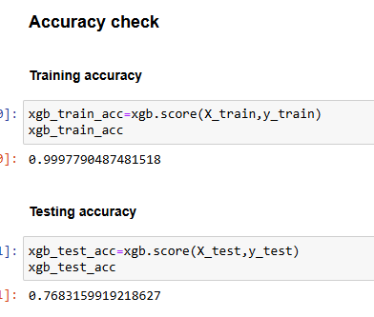
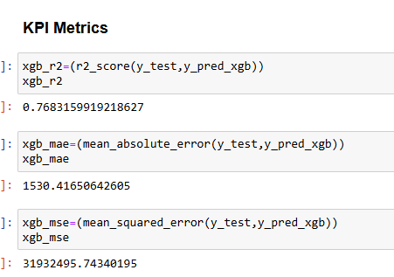
XGBoost Regressor
Model showing good accuracy.
However there is more than 20% gap between testing accuracy and training accuracy.

Slide 20
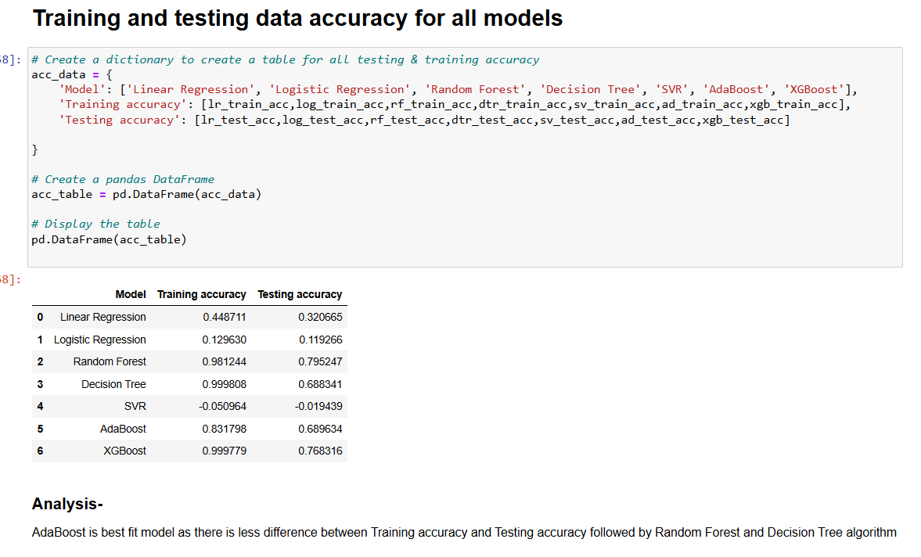
Model Analysis of all algorithms

Slide 21

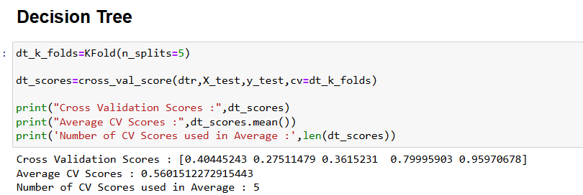
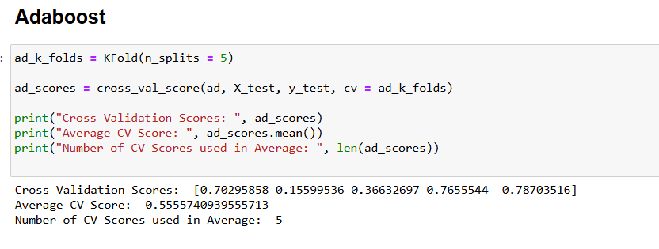
K-Fold Cross Validation for model evaluation
Importing K-Fold
Applying Cross validation on various algorithms

Slide 22
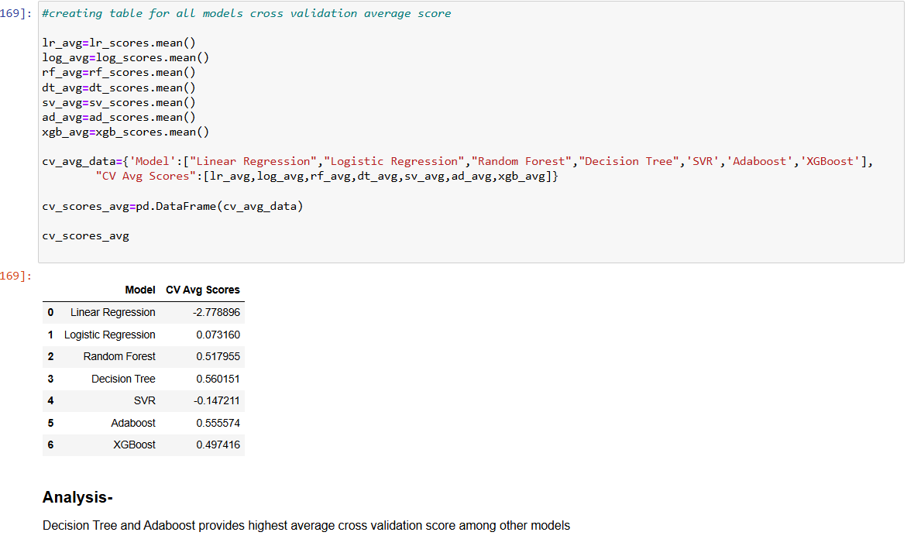
Cross Validation
Decision Tree and Adaboost provides highest average cross validation score among other models

Slide 23
THANK YOU !

